Slide 1
Recommendation System in-class report
Jianru Wang
001447006
Data Analytics Engineering

Slide 2
Main Idea
Recommendation System web application
Searching
Users can search activities nearby based on their location and input keywords
Saving
App will save users searching history automatically
Users can also save their favorite activities
Recommending
The content-based recommendation will recommend activities nearby, based on users favorite activities and searching history

Slide 3
Project Design – Client side
An interactive web page with three sub pages, corresponding with three main functions of this app
Providing User Interface, sending request to and getting response from Server
HTML/CSS: responsible for static pages
JavaScript/AJAX: responsible for event response, and data transition between Client and Server

Slide 4
Project Design – Server side
Web Service with RESTful APIs to handle HTTP request and response
Tomcat, as a Container, will manage Java Servlets
Java Servlets will handle the RPC request from Client
RESTful APIs inside Servlets, corresponding with each route, will handle the HTTP request(GET, POST, PUT, DELETE)
Each RESTful API will be connected with Database or with external APIs
If users are searching activities, RESTful API will connect to external APIs and return real-time event data, and connect to DB to store their history searching data
If users are saving their favorite activities, RESTful API will connect to DB to store these

Slide 5
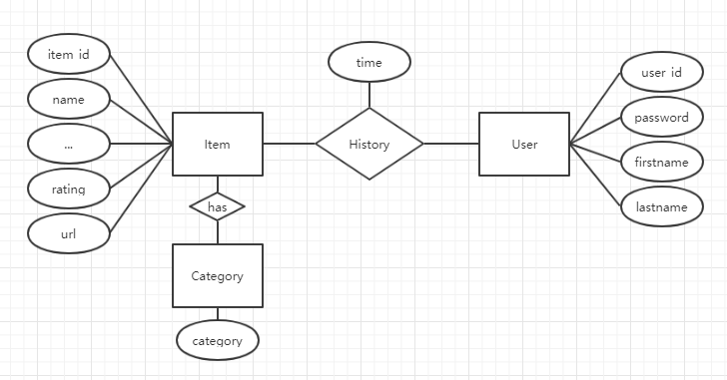
Project Design – Database
MySQL Database
Event data: event_id, name, distance, address, rating, image, url
User data: user_id, password, first_name, last_name
History data: user_id, event_id, time
Category data: event_id, category

Slide 6
Progress Report

Slide 7
JSON
{
address: "525 W Santa Clara San Jose",
distance: 10.34,
item_id: "G5vYZ4bQTCFxR",
image_url: "https://s1.ticketm.net/dam/a/f1a/f5350339-0002-4587-baed-f15e79becf1a_925311_ARTIST_PAGE_3_2.jpg",
name: "Paul McCartney - Freshen Up",
rating: 0,
categories: [ ],
url: "https://www.ticketmaster.com/paul-mccartney-freshen-up-san-jose-california-07-10-2019/event/1C005586BF3888AF"
}

Slide 8

Thank you

